Slide 1


MatchMind
Agentic AI-Powered Career Compatibility System
Ratheesh R

Slide 2

Problem Statement
To build an Agentic AI-powered Candidate-Company Compatibility Navigator that matches students with companies based on skills, cultural alignment, aspirations, and growth fit, using intelligent profiling, adaptive matching, and autonomous re-ranking.

Slide 3
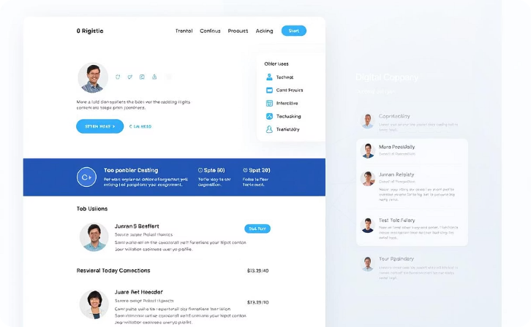


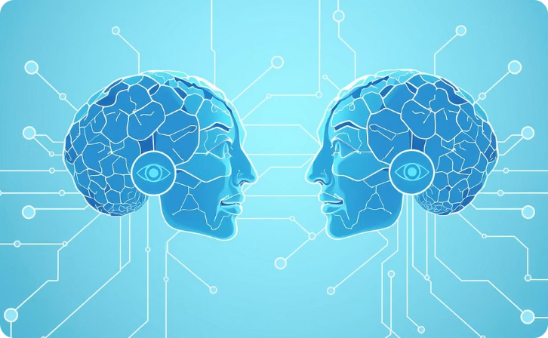
Architecture
Frontend (Vite.js + React)
Backend (FastAPI)
Database (MongoDB)
AI Agent Layer
Data Upload: Upload Resume, LinkedIn, Goals, Upload JD, Company Info
Dashboard: View Matches & Feedback
Intent Analyzer
Culture Extractor (RAG)
Skill Matcher (LLM + RAG)
Fit Scorer (0–100)
Counselor (Suggestions)
REST APIs
AI Agent Orchestration
Store Profiles,
Uploaded Data,
Report Generated
Full Architecture Link

Slide 4
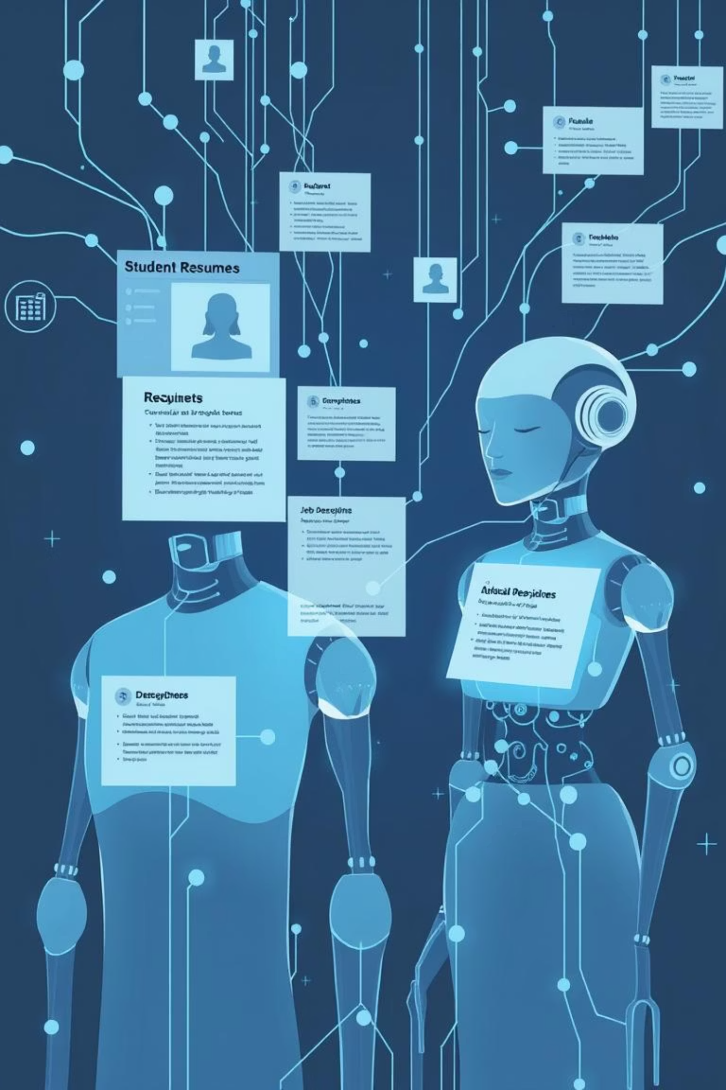





Proposed Solution
Uploads: Resume, LinkedIn, Goals , Company , Company URL, JD
Intent Analyzer: Extracts preferences, goals , etc.….
Company Culture Agent: Maps work culture , preference , etc.…
Skill Alignment Agent: Maps skills, finds gaps , etc.…
Fit Scorer Agent: Calculates Compatibility Score
Counselor Agent: Generates match reasoning, advice

Slide 5
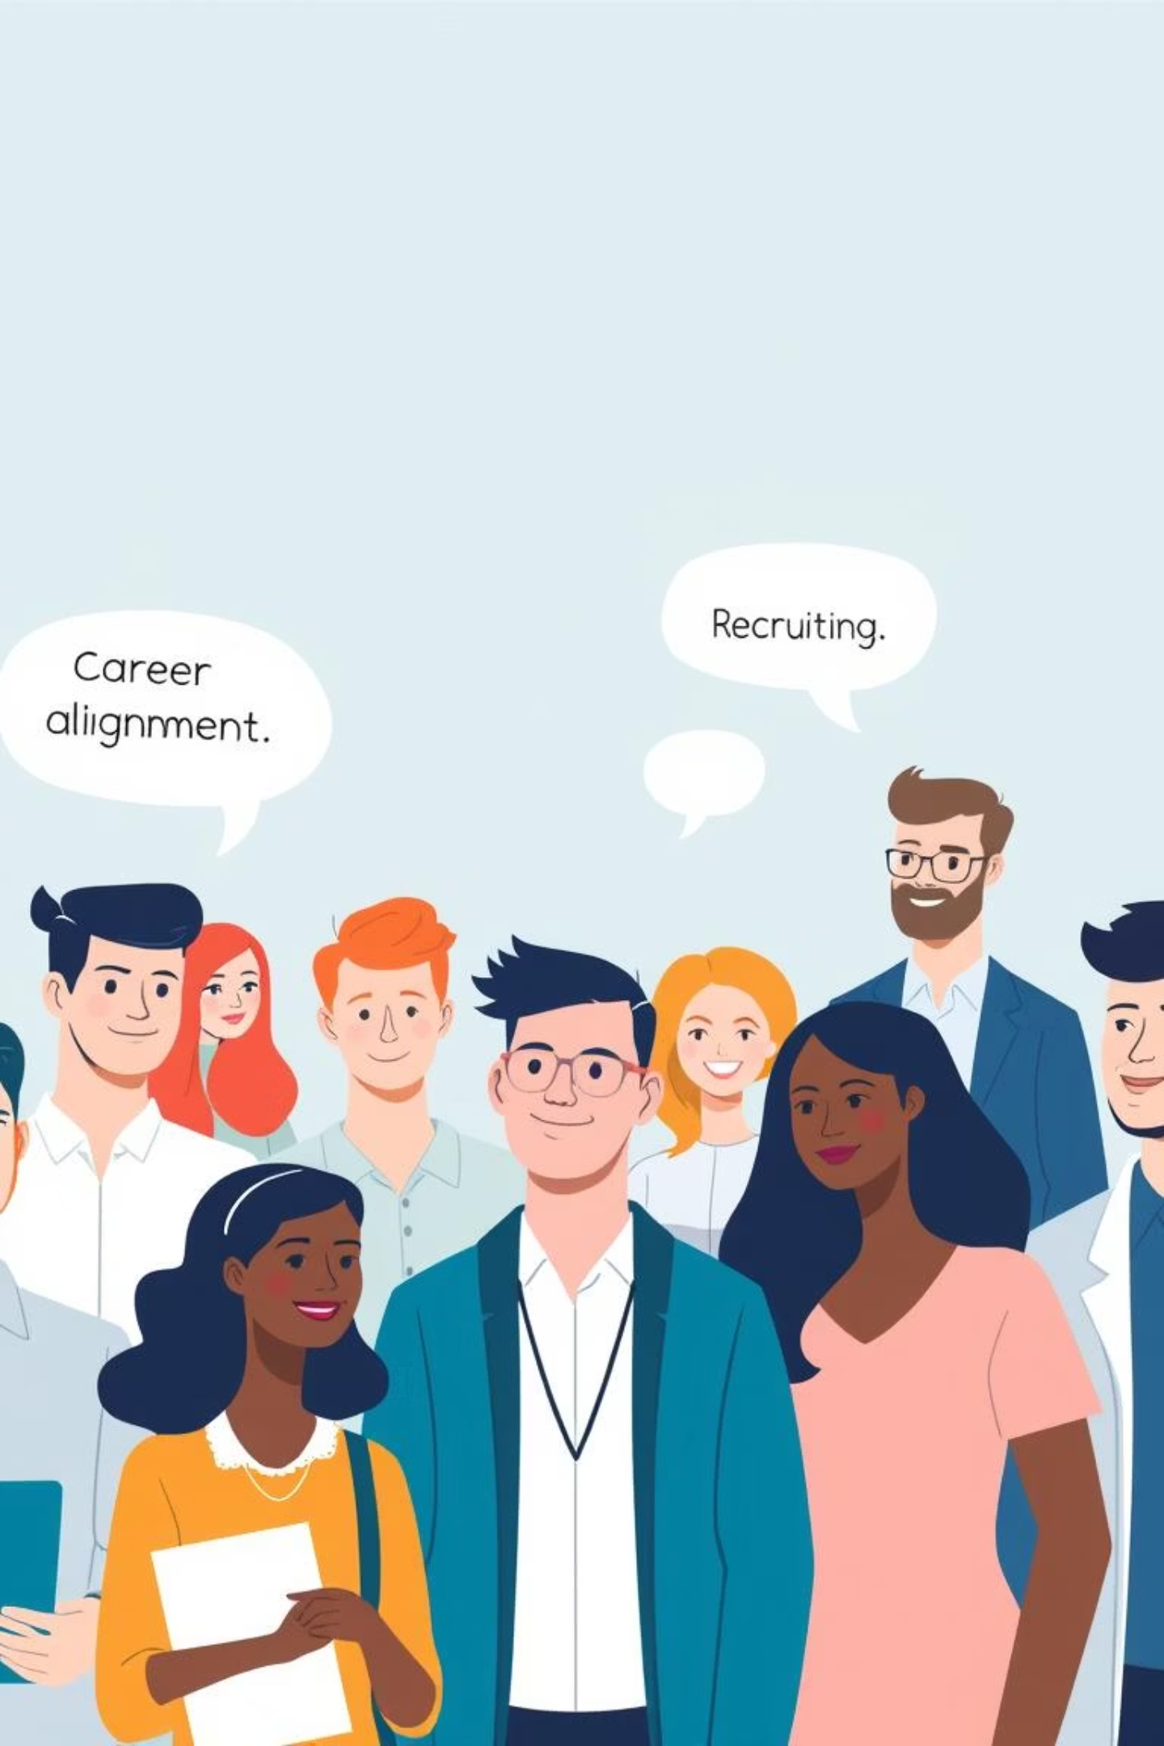
Benefits
For Students:
For Recruiters:
Career matching
Transparent compatibility scores
Actionable counseling feedback
Higher satisfaction & motivation
Smarter candidate shortlisting
Better retention (culture fit)
Explainable, Al-powered evaluations

Slide 6

Thank You

